Slide 1
CEIS101 Final Project
CEIS101 Final Course Project
January 2024
Lauren Wilson
Prof. Koonjbearry

Slide 2
Introduction
Over the course of this project, I learned how to assemble a smart home security system piece by piece. Each week we were taught to add more elements to the project and saw how they worked in the system. The class achieved this by using Office, Excel, Word, Tinkercad, and Canvas.

Slide 3
CEIS101
Module 2
Circuit Simulation in Tinkercad

Slide 4
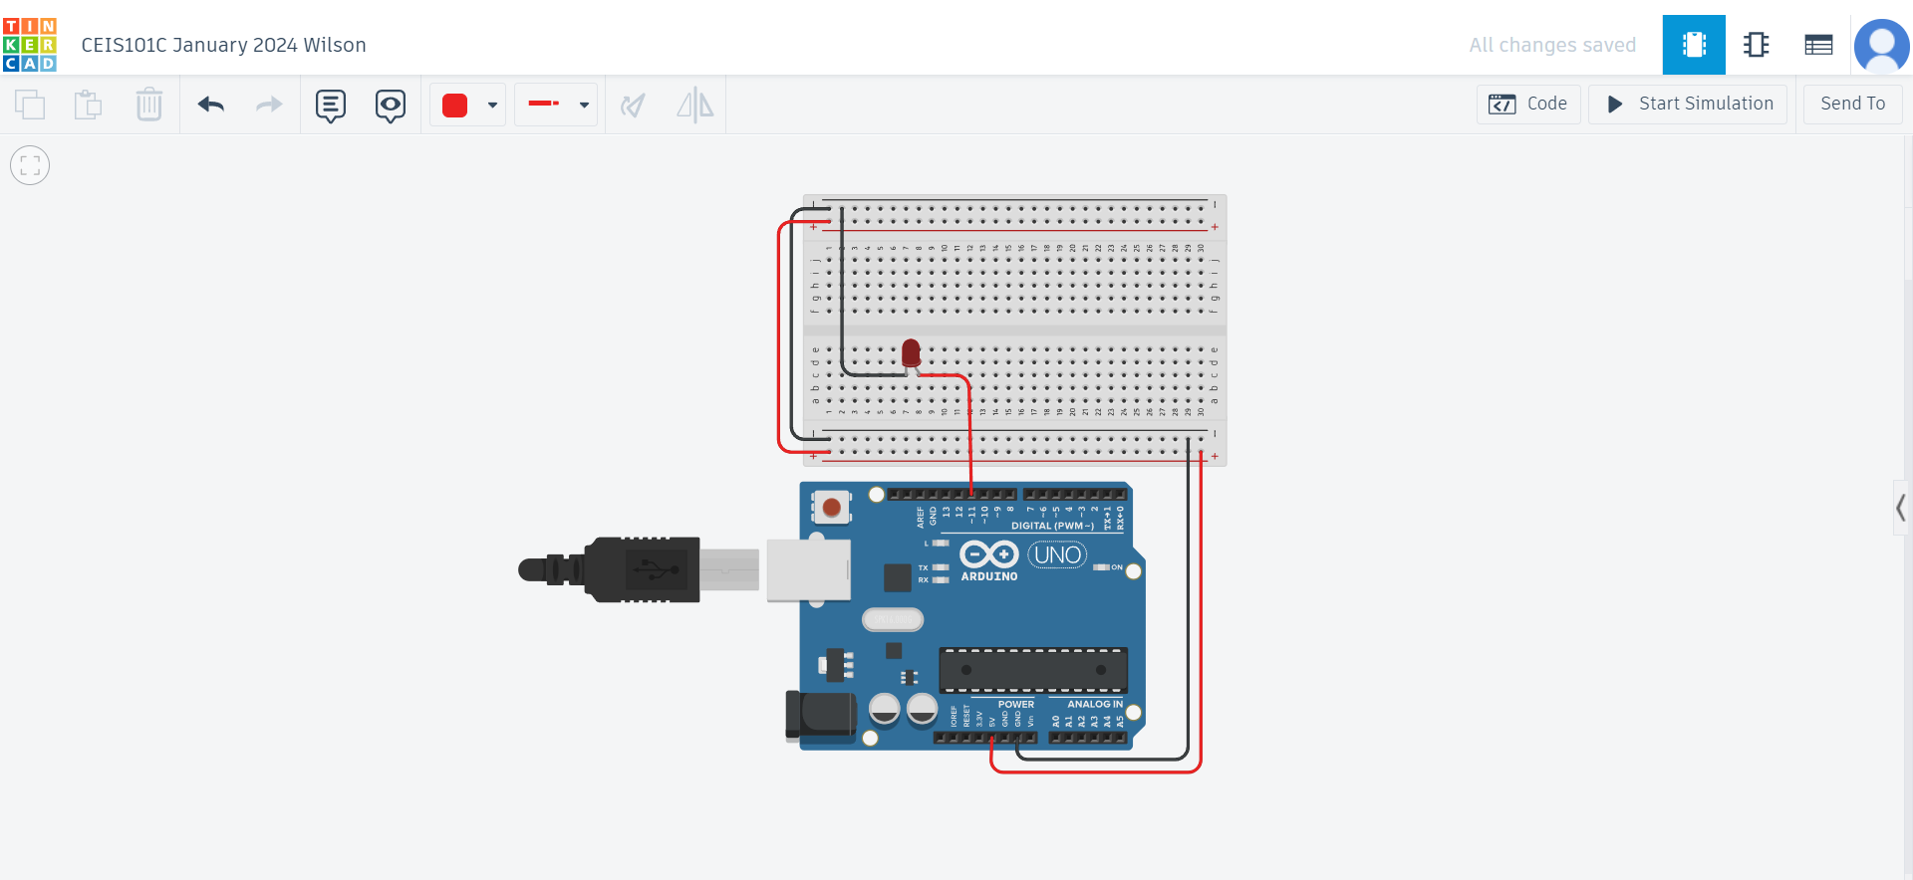
Circuit (screenshot)

Slide 5
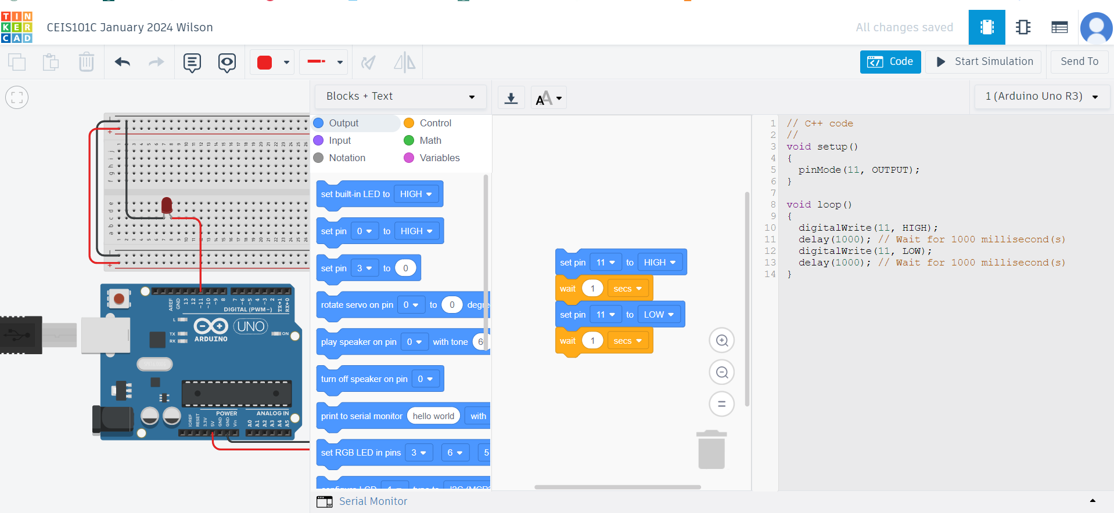
Code (screenshot)

Slide 6
CEIS101
Module 3
Inventory of Parts, Circuit Building, and Displaying Messages

Slide 7
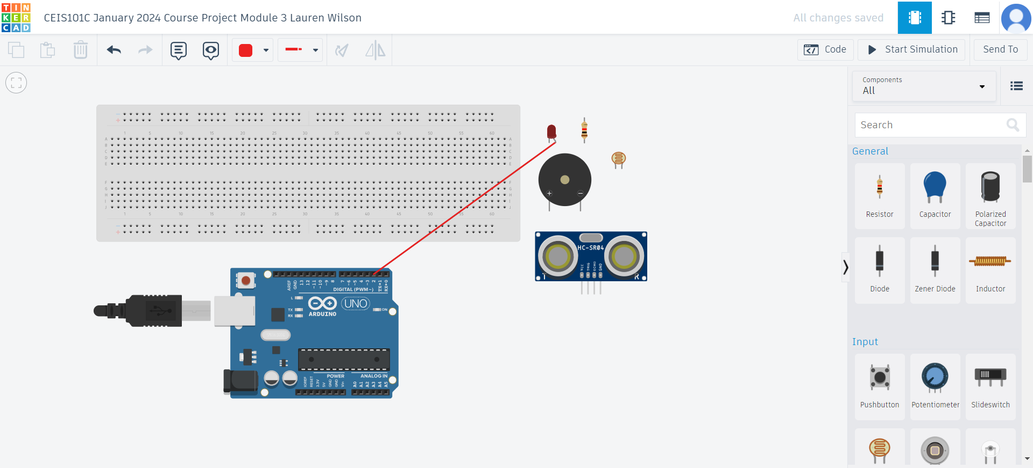
Organization of Project Components (picture)
Arduino Uno
Breadboard
Resistor 10kΩ
LEDs
Ultrasonic Sensor
Active Buzzer
Photoresistor
Wires

Slide 8
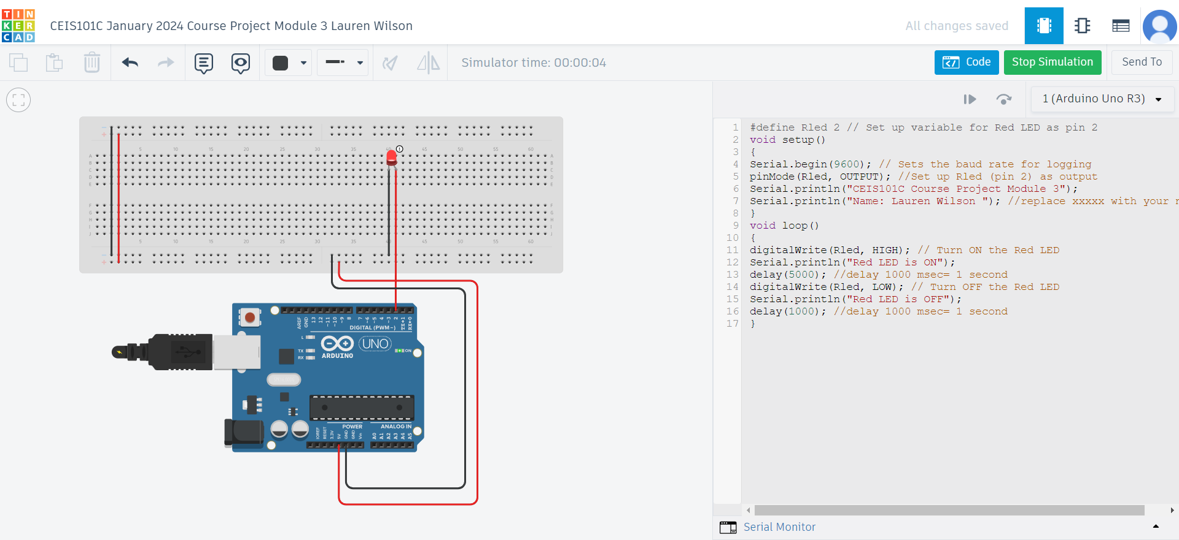
Circuit with red LED on (picture)

Slide 9
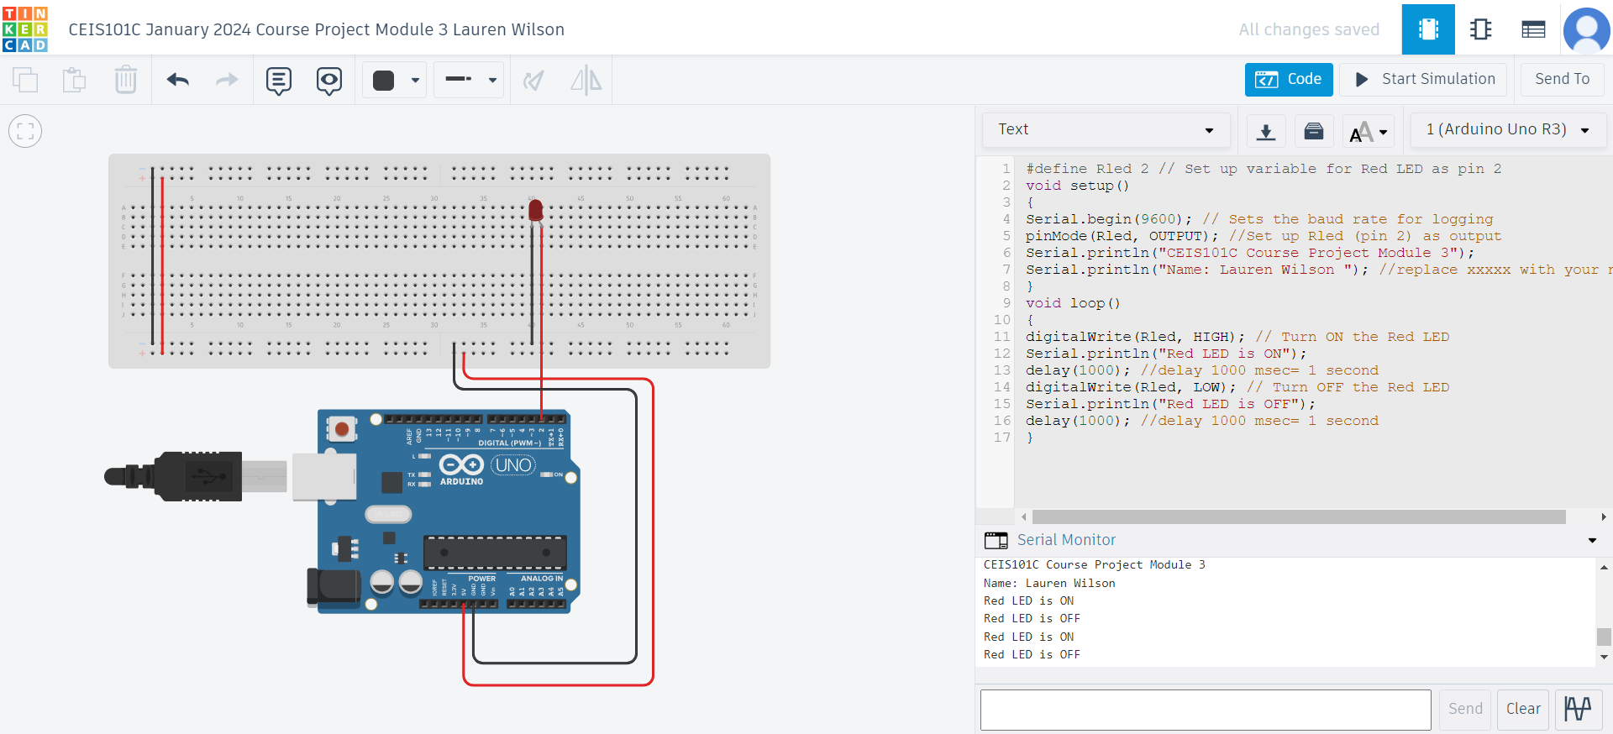
Serial Monitor (screenshot)

Slide 10
CEIS101
Module 4
Adding Door Sensor to Smart Home System

Slide 11
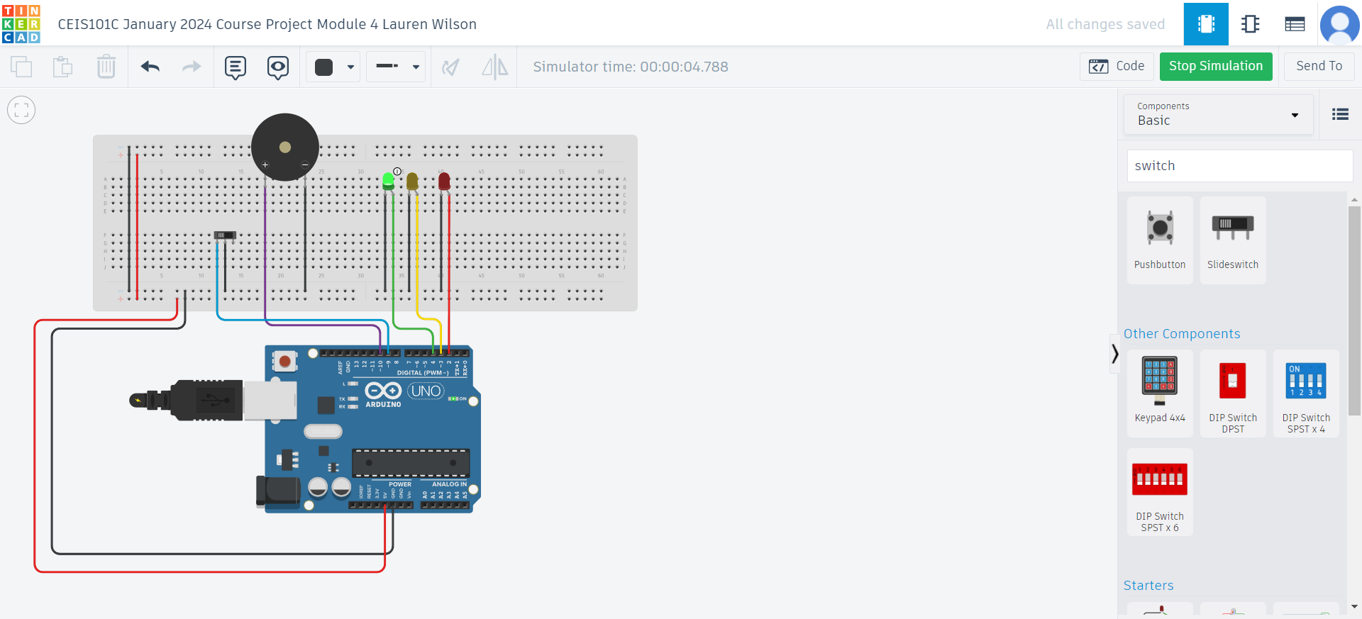
Circuit of door closed with Green LED ON (picture)

Slide 12

Circuit of door open with Green LED OFF (picture)

Slide 13
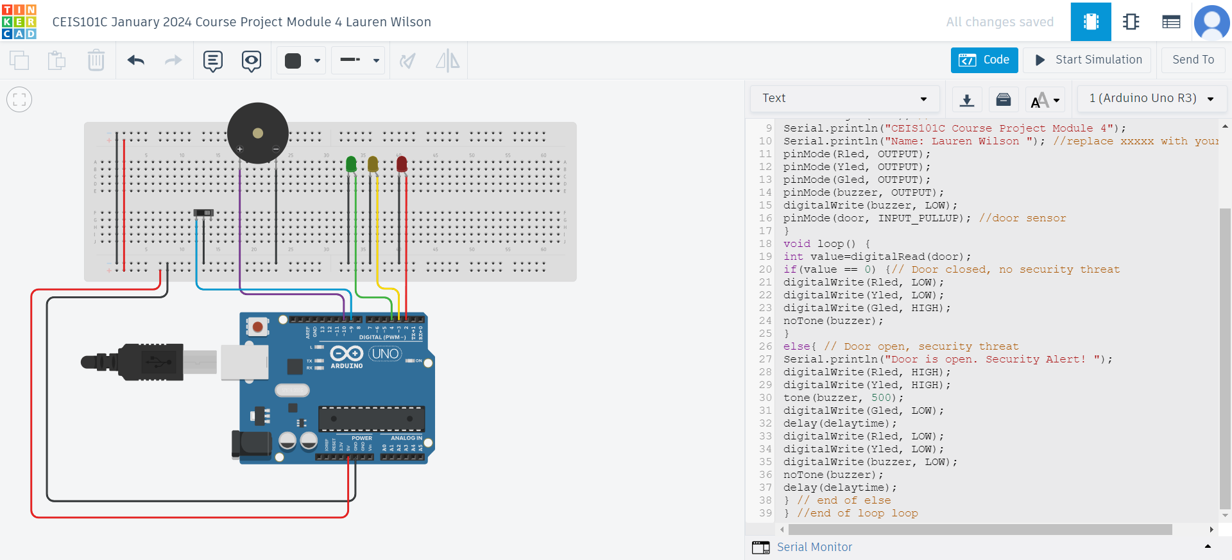
Arduino Code (screenshot)

Slide 14
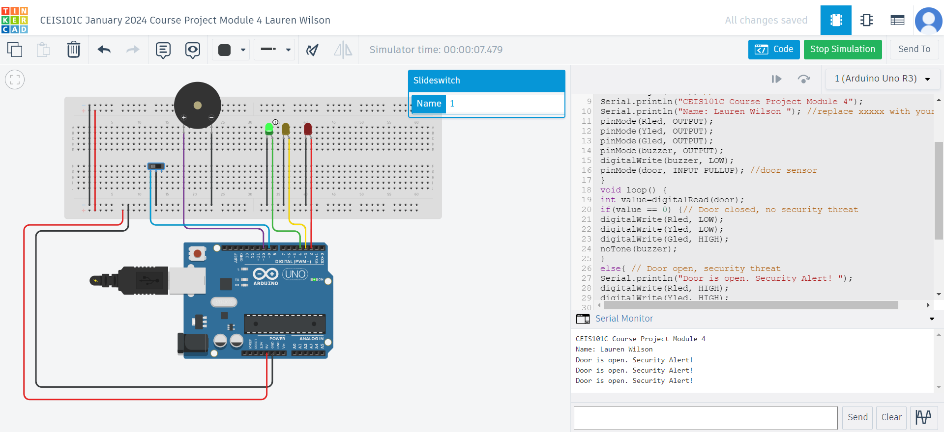
Serial Monitor (screenshot)

Slide 15
CEIS101
Module 5
Adding Distance Sensor to Smart Home System
and Conducting Data Analysis

Slide 16
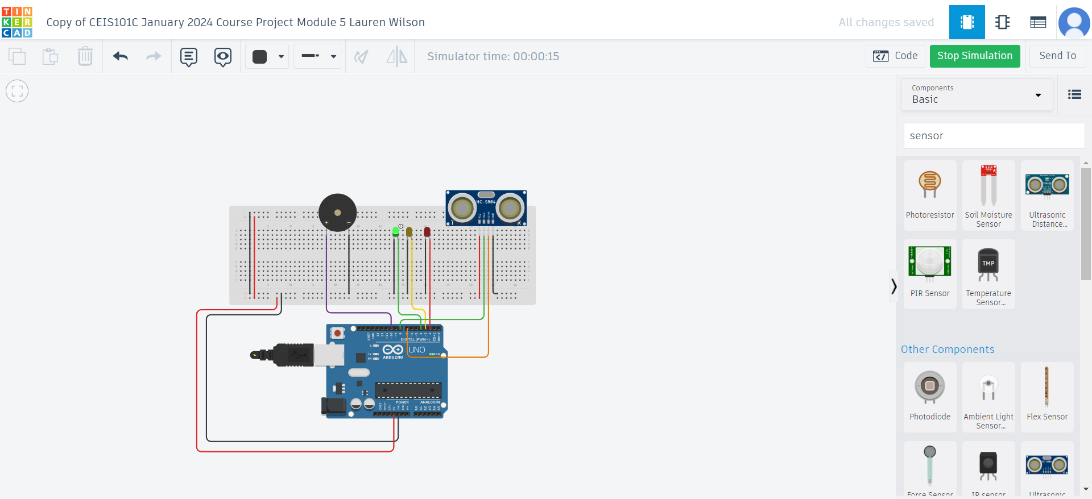
Circuit with green LED on (picture)

Slide 17
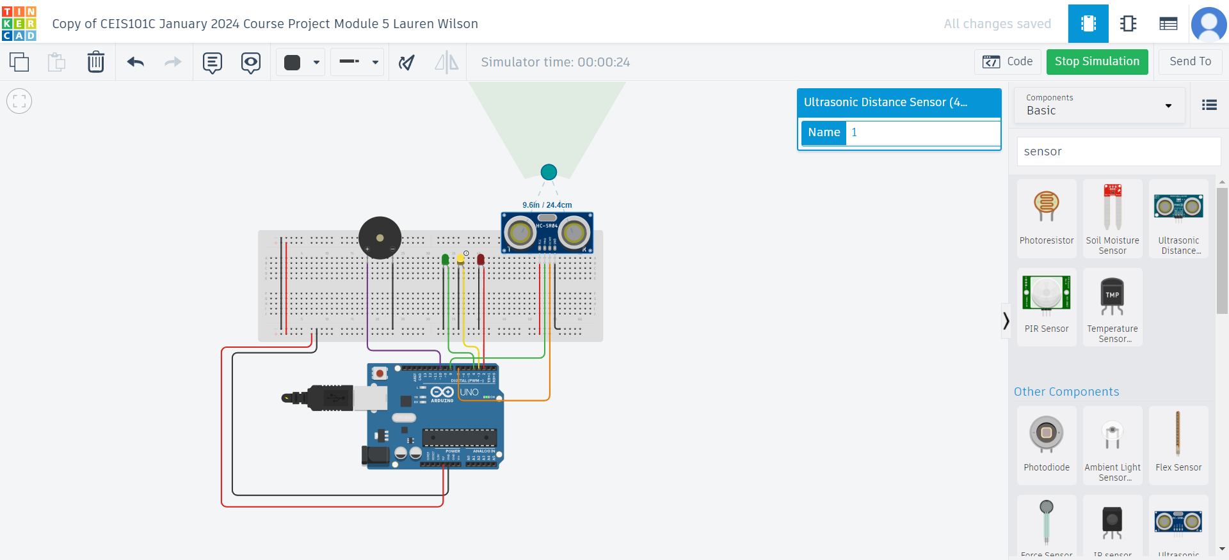
Circuit with yellow LED on (picture)

Slide 18
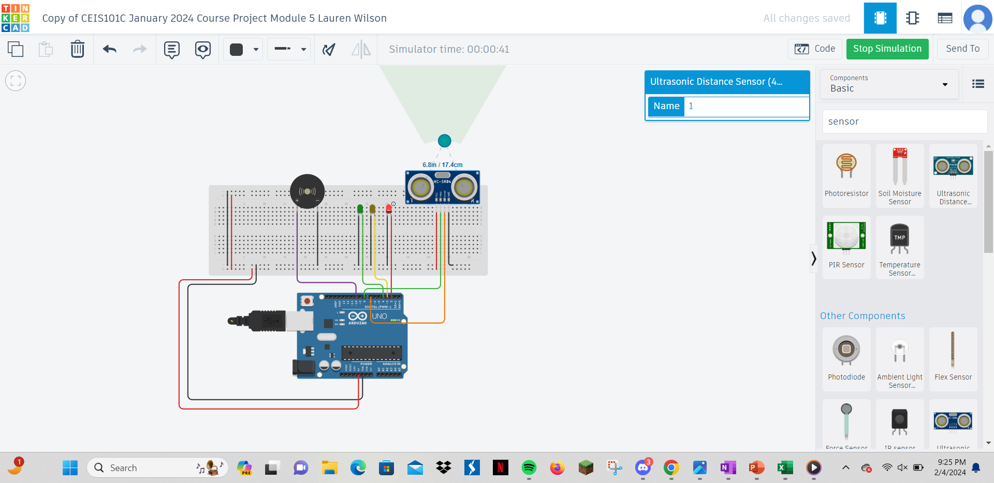
Circuit with red LED on (picture)

Slide 19
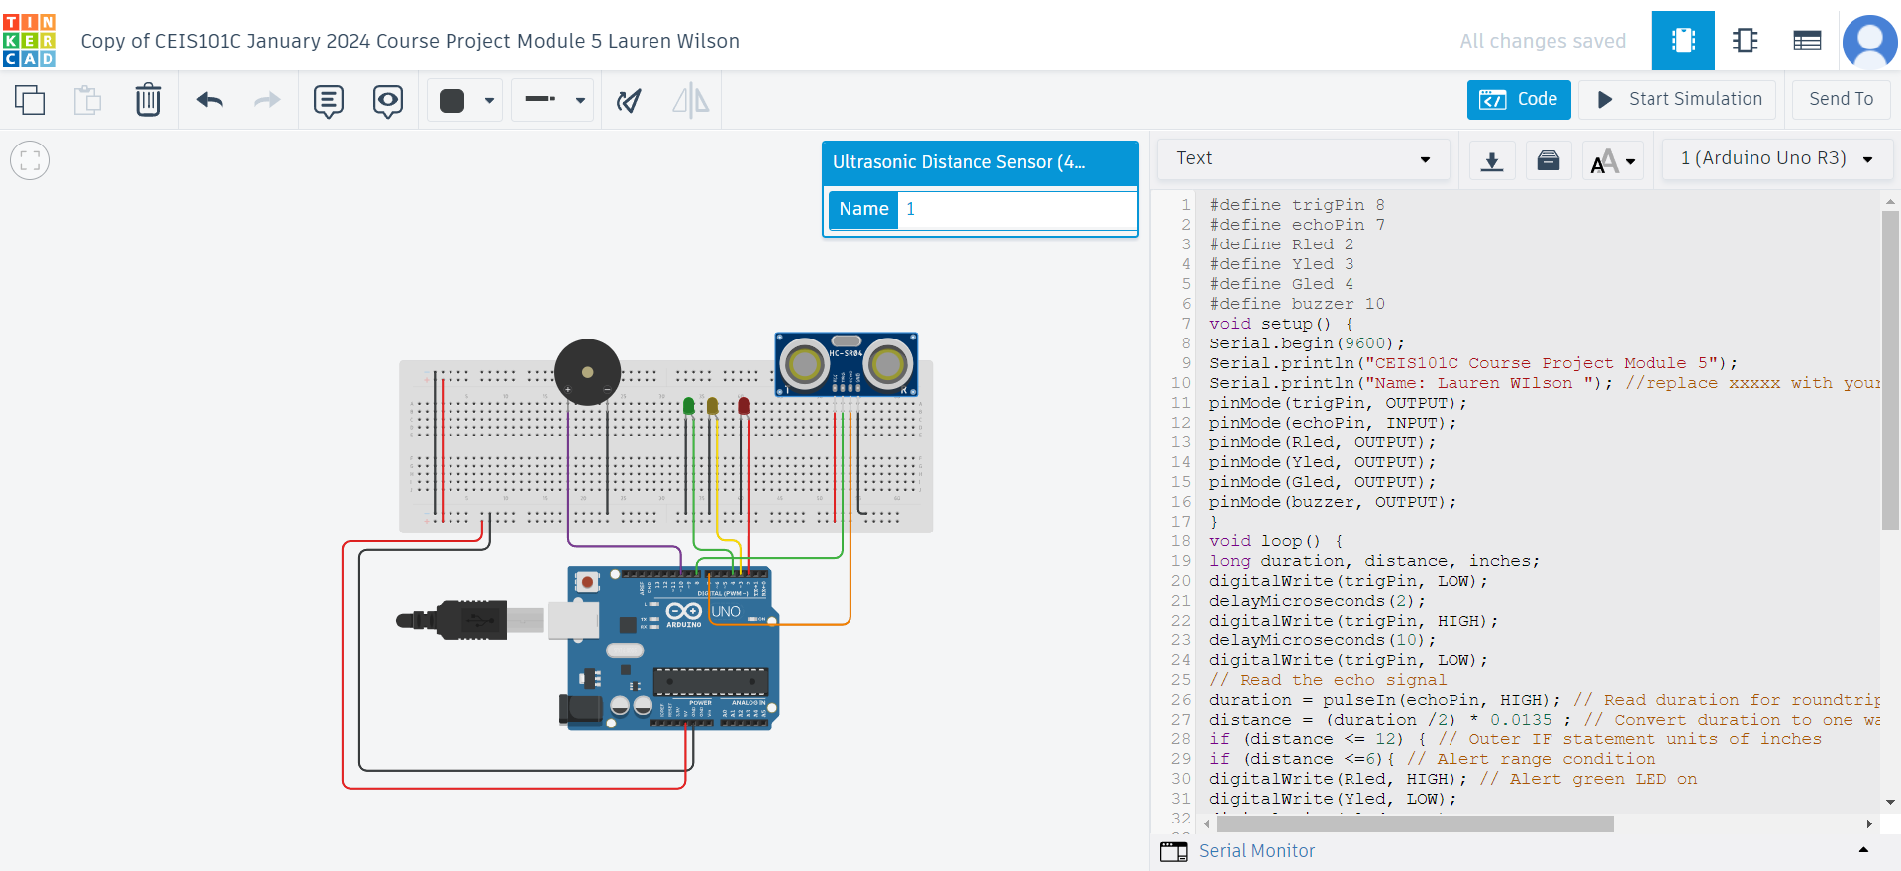
Arduino Code (screenshot)

Slide 20
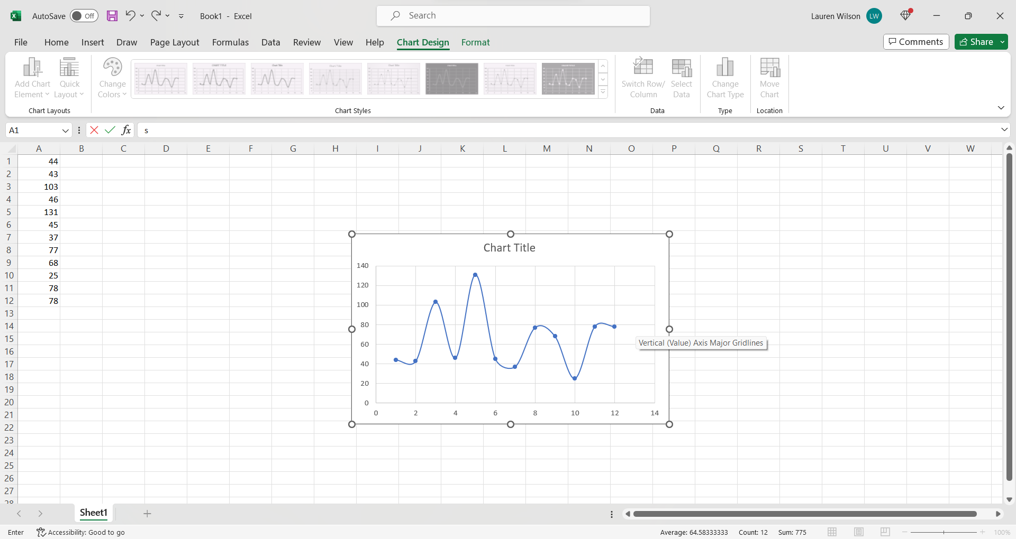
Plot of data (graph from Excel)

Slide 21
CEIS101
Module 6
Adding Automated Light to Smart Home System

Slide 22
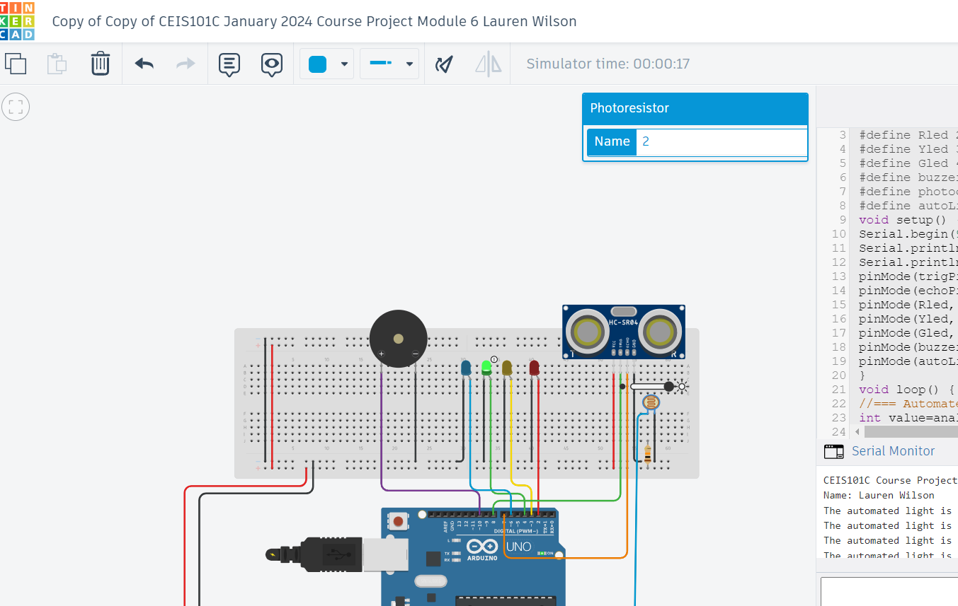
Circuit with automated LED off (picture)

Slide 23
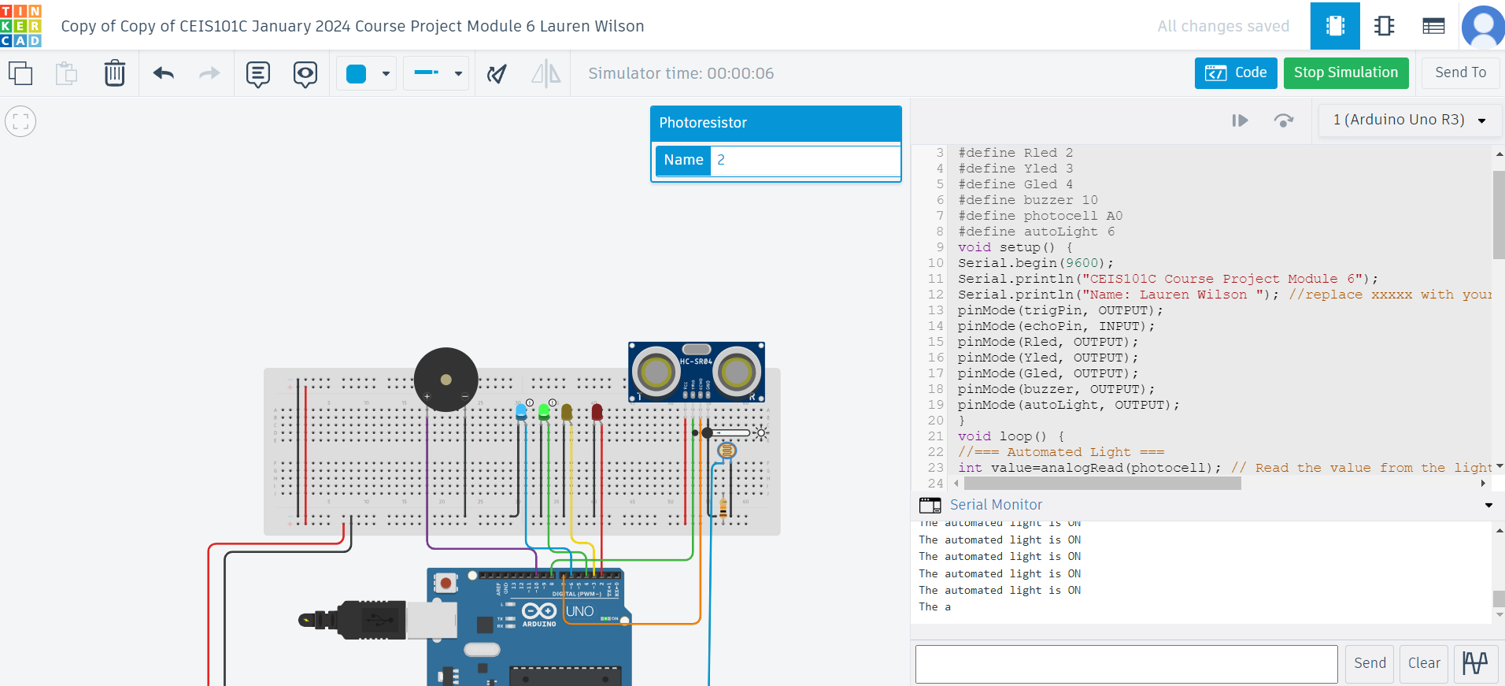
Circuit with automated LED on (picture)

Slide 24
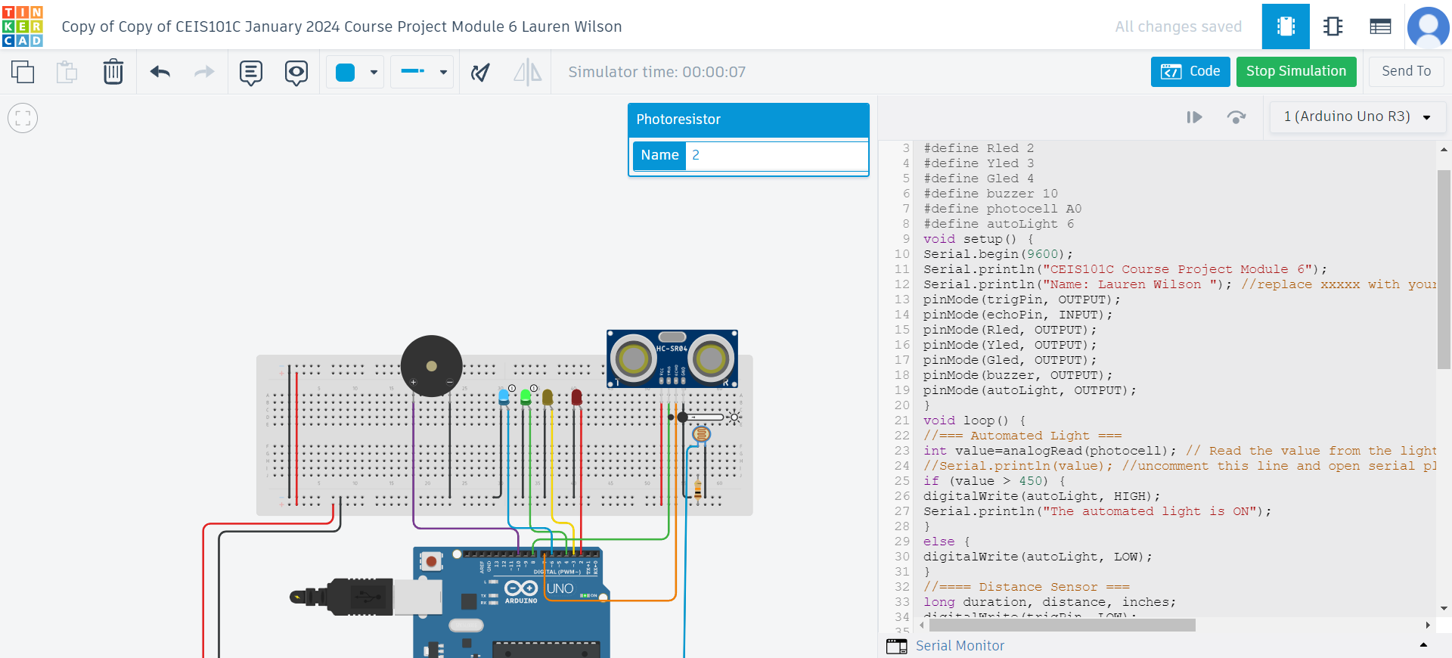
Arduino Code (screenshot)

Slide 25
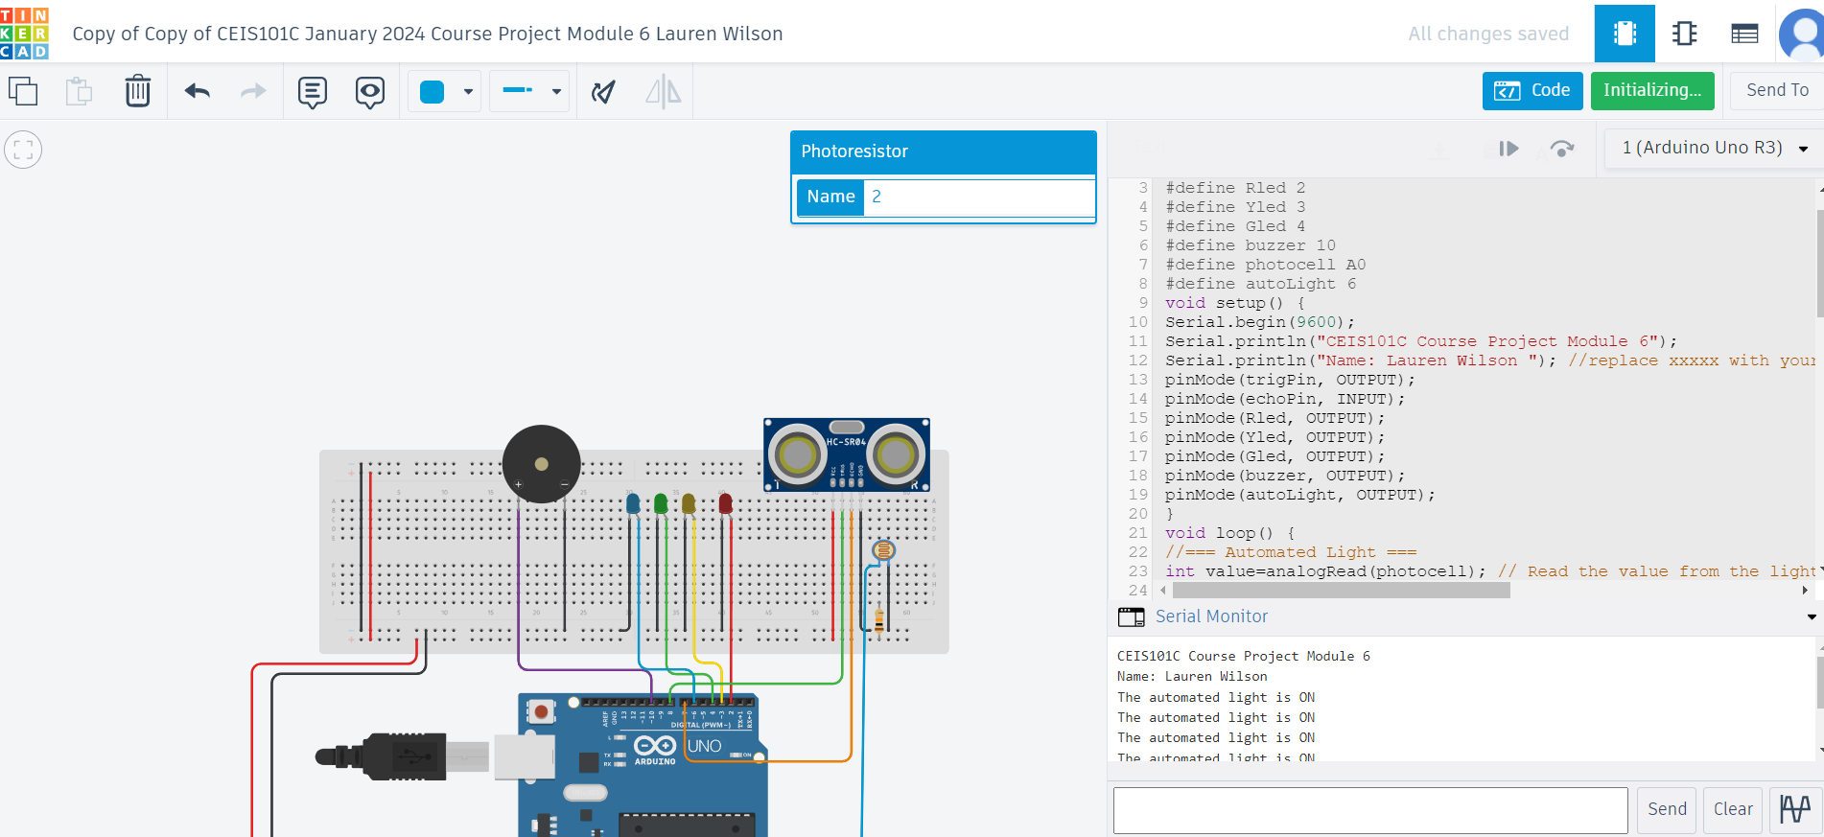
Serial Monitor (screenshot)

Slide 26
Challenges/Lessons Learned
These weekly projects were not only stimulating but provided some rewarding challenges!
It made me more comfortable with the inner workings of my computer. I am quite new to learning the ins and outs of tech, and it made me learn a lot of new, useful shortcuts and applications. For example, how to make my screenshotting app work more in my favor!
Another challenge was correcting code. There was one week that my code would not copy correctly, but from watching my professor correct something in a previous week I was able to rearrange it so my code would work! It was a very simple thing, but as I do not know much about code yet I was proud of myself.

Slide 27
Career Skills
Here are some skills I learned not only form this project, but from this course on a whole!
How to work in Tinkercad
Graphing skills
The fundamentals of technology itself
The usage of the tools listed in slide 2
How the pieces of this project work together to build one cohesive unit
Altogether these things are skills that I know will further my career and lead to success!

Slide 28
Conclusion
In conclusion, this was a wonderful introduction to the way technology works and some of the basic skills that go hand in hand with that. It was an introduction not only to that, but coding and different coding languages. It was very rewarding to see this project come together over the weeks, and to expand my knowledge in this field. After getting to know how Tinkercad works, I am excited to continue ‘tinkering’ with it and to make new things!

Slide 29
References
My sources for this project came from my DeVry course material.

