Slide 1
Final Course Project
By Lauren Wilson
For CEIS106

Slide 2
Starting In Week !
During week 2 we learned to explore the Linux file systems, how to manage files and directories, and we explored the file and directory permissions

Slide 3
Navigate the Linux filesystem tree
1. What is the pwd command an acronym for? What about the cd command?
Answer here:
pwd: print working directory- shows the path for the current directory
cd – change directory – change over to the directory you specify
2. Explain the differences between a relative path and an absolute/full path in Linux.
Answer here:
Relative path – path based on your current location
Absolute path – path starting from the very top of the file system, which is the root -- /
References:
1. Project video
2. Textbook

Slide 4
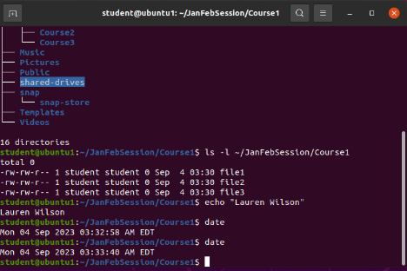
Create directories and files
Take a screenshot of the output in Steps 5 and 6
For some reason, the correct date and time was not showing up in the server.
Sat 23 Mar 2024 06:00 PM CT

Slide 5
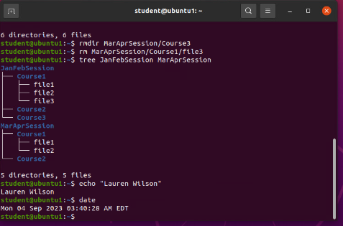
Copy and remove directories and files
Take a screenshot of the output in Step 3.
The date and time were not showing up correctly, I will add in notes
Sat 23 Mar 06:07 PM CT

Slide 6
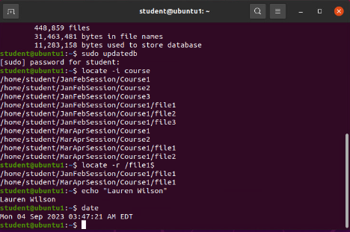
Locate directories and files
Take a screenshot of the output in Steps 5 and 6.
The date and time were not showing up correctly. I will add in notes.
Sat 23 Mar 2024 06:14 PM CT

Slide 7
Week 3
During week 3 we learned about Shell scripts and how they can manipulate command input and output.

Slide 8
Create a shell script
1. What are the file permissions of the script?
Answer here:
rw- rw- r–
Read/write owner – read/write group- read only for everyone else
2. What’s the name of the user-defined variable in the script?
Answer here:
text
3. Which redirection meta-character is used in the script? What does it do?
Answer here:
>> -- redirects to the file and appends to the end of the file
References:
Project video
2. Textbook

Slide 9
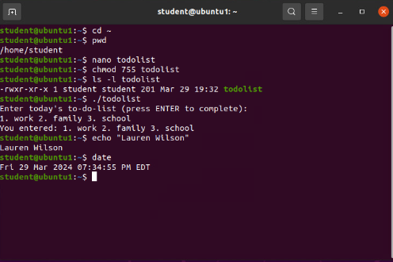
Change script file permissions
Take a screenshot of the output in Step 5.

Slide 10
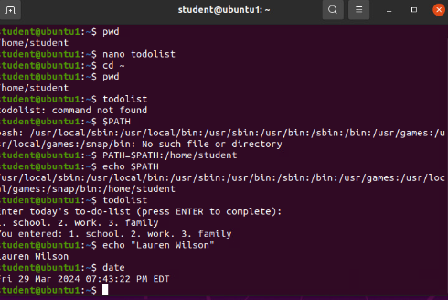
Set the PATH variable
Take a screenshot of the output in Step 6.

Slide 11
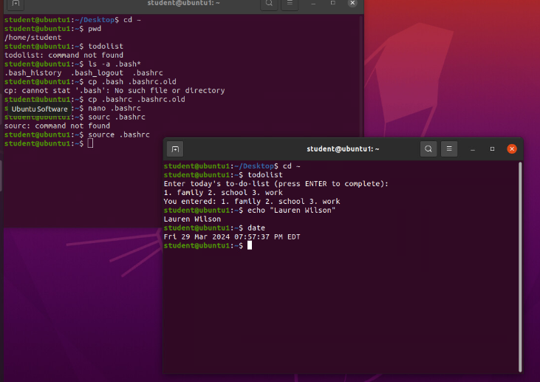
Make the PATH variable permanent
Run the todolist script before and after making the PATH variable permanent. Take a screenshot of both Terminal windows.

Slide 12
Week 4
During week 4 we looked at the essential parts of Linux administration and how to execute those functions.

Slide 13
Add users and groups in CLI
1. What does the –m option in the useradd command do?
Answer here:
-m – tells the useradd command to create a home directory for the new user
2. What does the -3 option in the tail command do?
Answer here:
-3 – tells tail command how many lines to show from the end of the file
3. Which line of the /etc/group file lists members of the “students” group? Copy it here.
Answer here:
Students:x:1002:student,mary
References:
1. Project Video
2. Textbook

Slide 14
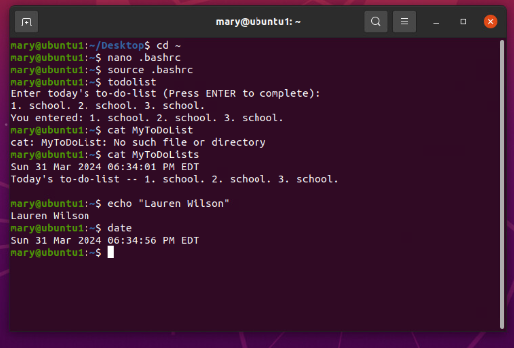
Test user and group settings
Take a screenshot of the output in Step 6.

Slide 15
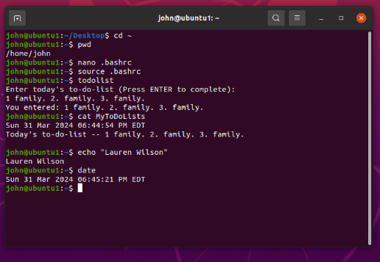
Add users in GUI
Take a screenshot of the output in Step 9.

Slide 16
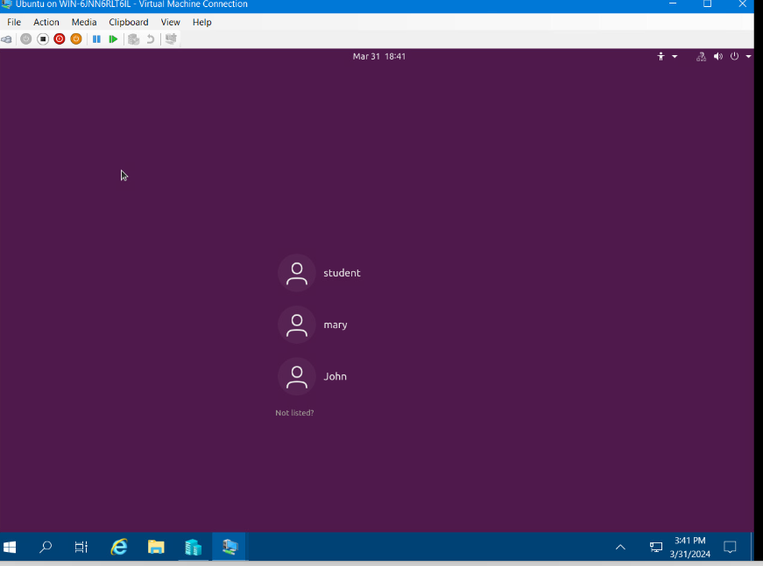

Remove users and groups
Take a screenshot of the log on page with three user accounts.
Take a screenshot of the log on page with only your user account (i.e., student).

Slide 17
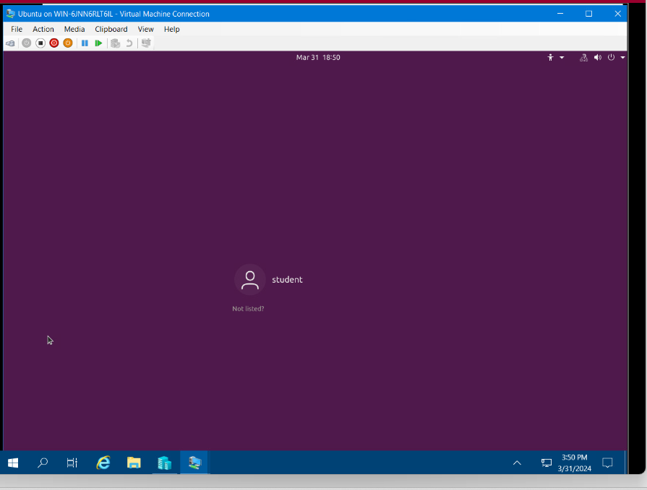
Remove users and groups
Take a screenshot of the log on page with three user accounts.
Take a screenshot of the log on page with only your user account (i.e., student).

Slide 18
Week 5
During week 5, we learned how to configure Linux to participate on a network.
As a part of this we looked at the configuration of networks that provide essential serviced that we are all familiar with such as web and email.

Slide 19
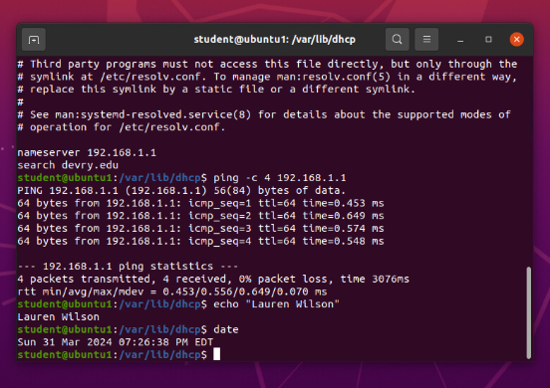
Discover host IP configurations
1. What is the IP address of your Ubuntu machine?
Answer here:
192.168.1.107
2. What is the IP address of its default gateway?
Answer here:
192.168.1.1
3. What is the IP address of its DHCP server?
Answer here:
192.168.1.1
4. What is the IP address of its DNS server?
Answer here:
192.168.1.1
Take a screen capture of the output in Step 12.

Slide 20
Manage network interfaces
1. Which DHCP message is shown in the output of the sudo dhclient –v –r ens33 command?
Answer here:
DHCPRELEASE
2. Which four DHCP messages are shown in the output of the sudo dhclient –v ens33 command?
Answer here:
DHCPDISCOVER
DHCPOFFER
DHCPREQUEST
DHCPACK

Slide 21
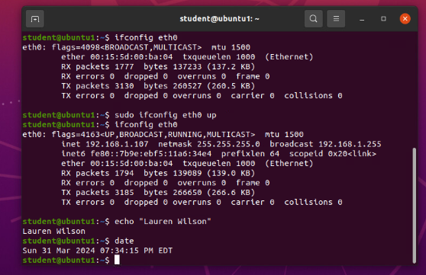
Use network utilities
Take a screen capture of the output in Step 7 and Step 8.

Slide 22
Week 6
Lastly, we learned how to do maintenance on the Linux system. Such as securing, troubleshooting, and monitoring different things that could cause issues.

Slide 23
Monitor Linux processes
1. What is the default action of the 15 SIGTERM kill signal?
Answer here: kill the highlighted process
2. In the System Monitor window, click on % CPU to sort the processes by CPU load. Which process shows the highest percentage of CPU usage?
Answer here: gnome-shell (GUI)
References:
1. Project Video
2.Textbook

Slide 24
Monitor user activities
Issue the sudo accton on command to turn on GNC accounting. Run the sudo updatedb command. Enter lastcomm updatedb to check if the updatedb command was executed before. Remember to turn off GNC accounting (sudo accton off) after answering the questions.
1. What flag value is displayed in the output?
Answer here: S – super user
2. Why is the name of the user who ran the processes shown as root, not student?
Answer here:
Super user – since I typed sudo in front of the command
References:
1. Project video
2. Textbook

Slide 25
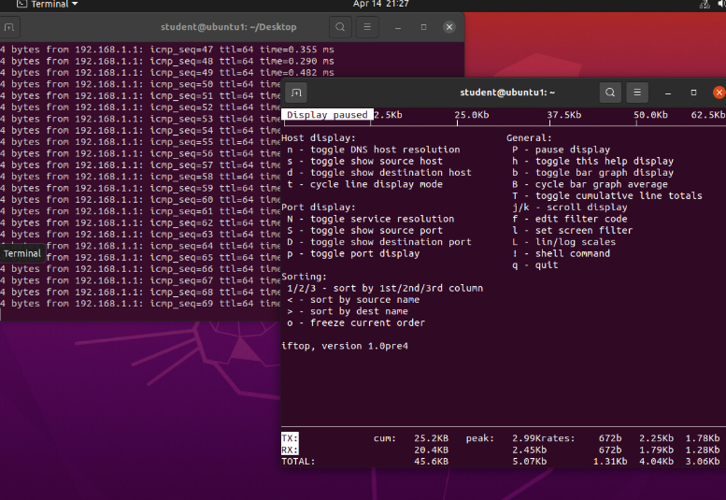
Monitor network bandwidth usage
Take a screenshot of the output in Step 4.

Slide 26
In conclusion, this course fully taught me the ins and outs of the Linux system as someone who was not familiar with the system. This course also prepared me for the Linux+ certification exam and provided all of the necessary tools to achieve success
I would say that it gave me the necessary career skills to succeed in this field.

